Slide 1
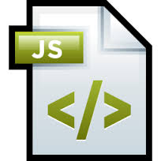
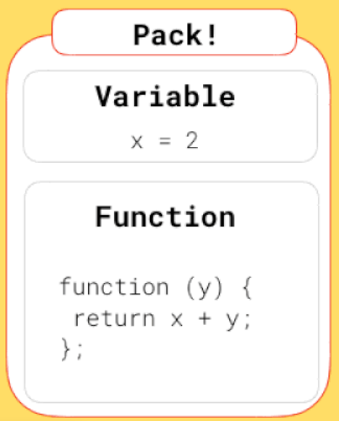
Java Script Closures

Slide 2
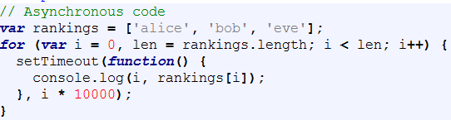

Javascript Asynchronous Code
The intrinsic nature of asynchronous code is that its execution block can occur independently of the main program flow, thus providing a non blocking mechanism of executing actions. This means that, potentially, when the asynchronous code runs the status of any shared variables could be different than the one where the code was defined. For Eg.
The idea is to print every name from the rankings array together with its index. To make the code asynchronous every print is delayed by one second from its predecessor. The output we get is, however, different than what we expected it to be:

Slide 3
Asynchronous Code
As you can see, by the time the asynchronous block is executed, the loop is already ended, so the value of variable i is the one that stops the loop (3). How to prevent this behavior? The answer are closures, one of the most powerful features of Javascript; a closure can be seen as a retained scope for Javascript, a function that can have its own variables together with an environment where those variables are binded.

Slide 4
What is closure?
In JavaScript, every time a function is created, a closure is associated to it.
In JavaScript, an inner (nested) function stores references to the local variables that are present in the same scope as the function itself, even after the function returns. This set of references is called a closure.
The inner function has access not only to the outer function’s variables, but also to the outer function’s parameters.
Closures in Javascript preserve all the local variables that existed in the function when it completed. This phenomenon of local variable preservation is referred to as Lexical Scoping.

Slide 5
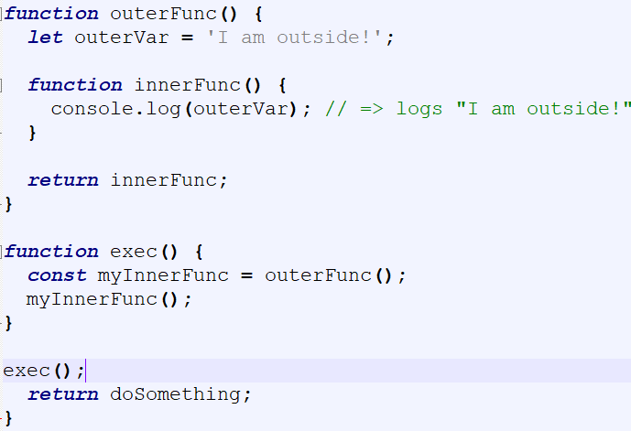
Lexical scoping w.r.t closure
The lexical scope allows to access the variables statically of the outer scopes.
The innerFunc() is executed outside of its lexical scope, but exactly in the scope of exec() function. And what's important is innerFunc() still has access to outerVar from its lexical scope, even being executed outside of its lexical scope.
In other words, innerFunc() is a closure because it closes over the variable outerVar from its lexical scope

Slide 6
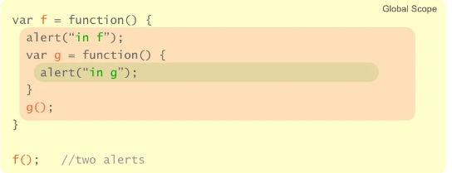
Is this a closure?

Slide 7
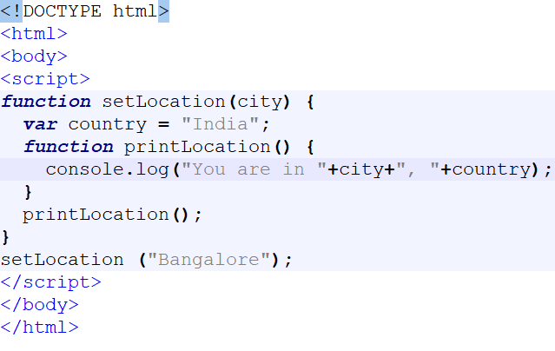
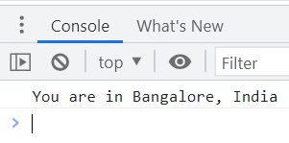
Answer
No
f() runs, it calls g(), then both functions exit.
There are no active references from the global scope to g().
A closure is the combination of a function and the lexical environment within which that function was declared. This environment consists of any local variables that were in-scope at the time that the closure was created.

Slide 8
Implementing Closures
function f(x) { function g(y) { return x + y; };
return g ;
}
var h = f(3);
var j = f(4);
var z = h(5);
var w = j(7);
h
global
undefined
w
j
undefined
z
undefined
undefined

Slide 9
Implementing Closures(1)
function f(x) { function g(y) { return x + y; };
return g ;
}
var h = f(3);
var j = f(4);
var z = h(5);
var w = j(7);
x
3
h
global
f
w
j
undefined
g
…
z
undefined
undefined

Slide 10
Implementing Closures(2)
function f(x) { function g(y) { return x + y; };
return g ;
}
var h = f(3);
var j = f(4);
var z = h(5);
var w = j(7);
x
3
h
global
f
w
g
…
z
j
undefined
undefined
x
4
f
g
…

Slide 11
Implementing Closures(3)
function f(x) { function g(y) { return x + y; };
return g ;
}
var h = f(3);
var j = f(4);
var z = h(5);
var w = j(7);
x
3
h
global
f
g
…
w
z
j
undefined
8
x
4
f
g
…

Slide 12
Implementing Closures(4)
function f(x) { function g(y) { return x + y; };
return g ;
}
var h = f(3);
var j = f(4);
var z = h(5);
var w = j(7);
x
3
h
global
f
w
g
…
z
j
11
8
x
4
f
g
…

Slide 13
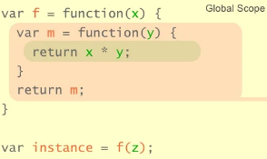
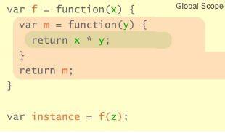
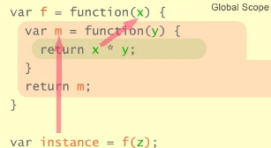
A simple closure
Look at the references which f() exist after f() has terminated
The only external reference we have is instance which points to m()
Within the scope of m() there is reference to x.
Given that x is the variable we want to “remember”. We can see that it continues to live because it is indirectly referenced from the global scope.
Also, note x is defined in m()’s present scope.

Slide 14
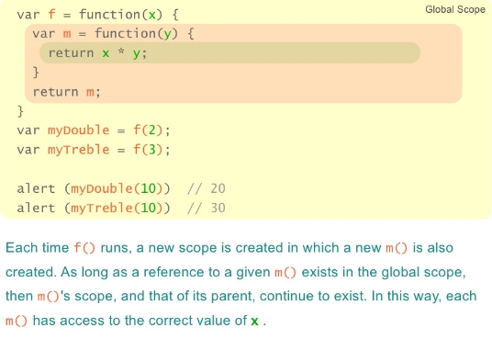
Closures contd…
Here we use our function factory to create two new functions — one that multiplies 2 to its argument, and another that multiples 3
myDouble and myTreble are both closures. They share the same function body definition, but store different lexical environments.
In myDouble 's lexical environment, x is 2, while in the lexical environment for myTreble x is 3.

Slide 15
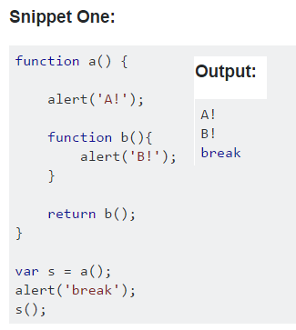
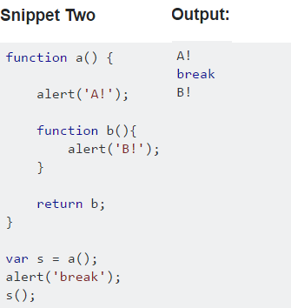
Example
return b();
// Execute function b() and return its value
return b;
// Return a reference to the function b() and assigned to var s.
Calling the function with () in a return statement executes the function, and returns whatever value was returned by the function. It is similar to calling var x = b().
Returning the function name without () returns a reference to the function, which can be assigned as you've done with var s = a(). s now contains a reference to the function b(), and calling s() is functionally equivalent to calling b().

Slide 16
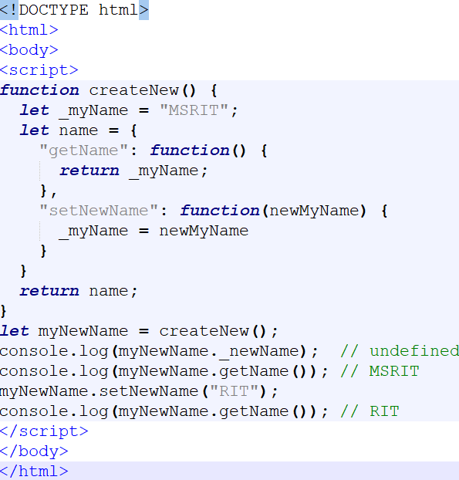
Using Closures to provide public/private data
There is a design pattern in JavaScript known as the Module pattern that provides a means for public/private data access (similar to the concept of access modifiers like public , private , protected in Java). It does this by making effective use of scopes and closures.
This example shows a name object that contains a private name variable and public getter/setters. In this example; _myName is contained in the scope of the createNew() function and not the returned name object (therefore not accessible), but because returned functions retain their scope history (i.e. a closure), we can access that data using “public” functions. Note: it is a JavaScript convention to use an underscore prefix to denote intended private-access variables.

Slide 17
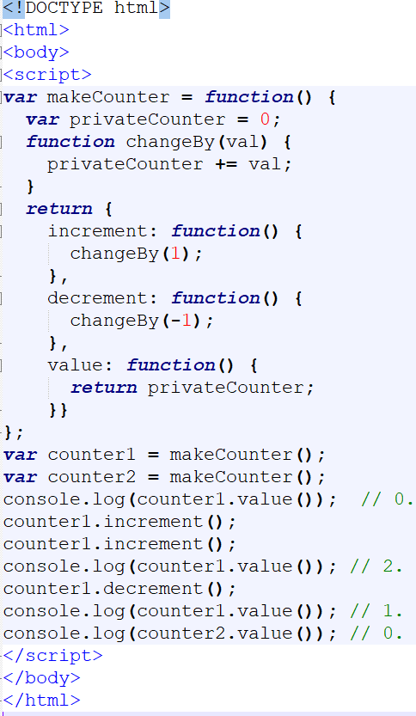
The following code illustrates how to use closures to define public functions that can access private functions and variables. Note that these closures follow the Module Design Pattern
In previous examples, each closure had its own lexical environment. Here though, there is a single lexical environment that is shared by the three functions: counter.increment, counter.decrement, and counter.value.

Slide 18
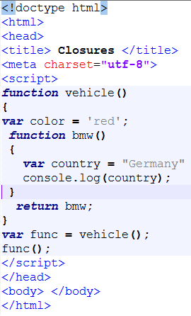
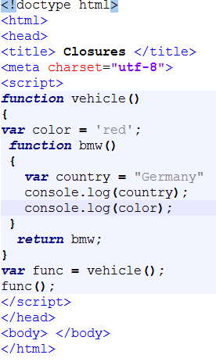
Nested function vs closures

Slide 19
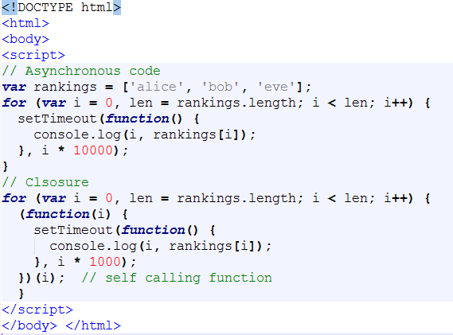
Converted asynchronous function to Closure

Slide 20


Function hoisting
Unlike variables, a function declaration doesn't just hoist the function's name. It also hoists the actual function definition.
Both lines create a simple function that just shows an alert, But they go about it differently. The first is a function declaration, and the second is a function expression, and your browser treats them differently. Remember, declarations get hoisted, but variable assignments don't, and that's essentially what `bar` is in this case: a variable whose declaration gets hoisted to the top of the scope, but whose value, in this case an anonymous function expression, gets assigned later on:

Slide 21
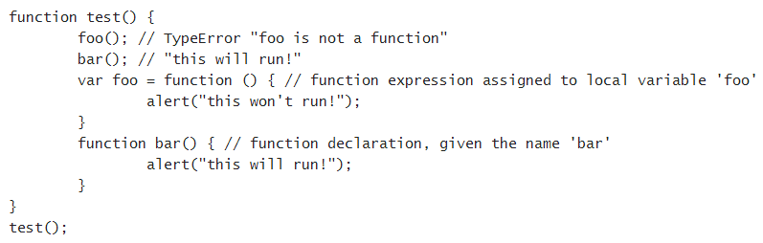
Consider the following JavaScript:
In this case, only the function declaration has its body hoisted to the top. The name ‘foo’ is hoisted, but the body is left behind, to be assigned during execution.

Slide 22
Another scope example
function f() {
var a = 1, b = 20, c;
console.log(a + " " + b + " " + c); // 1 20 undefined
// declares g (but doesn't call immediately!)
function g() {
var b = 300, c = 4000;
console.log(a + " " + b + " " + c); // 1 300 4000
a = a + b + c;
console.log(a + " " + b + " " + c); // 4301 300 4000
}
console.log(a + " " + b + " " + c); // 1 20 undefined
g();
console.log(a + " " + b + " " + c); // 4301 20 undefined
}

Slide 23
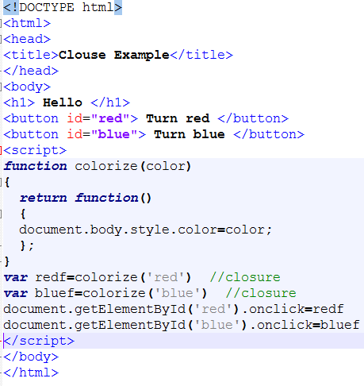
Practical closures
Situations where you might want to do this are particularly common on the web. Much of the code we write in front-end JavaScript is event-based — we define some behavior, then attach it to an event that is triggered by the user (such as a click or a keypress). Our code is generally attached as a callback: a single function which is executed in response to the event.

